Slide 1
Targeted transcranial magnetic stimulation (rTMS) for cognitive rehabilitation after traumatic brain injury

Slide 2
Introduction
Traumatic brain injury
Sequelae
~25,000 adults with new TBI/year¹
~50,000 with long term complications²
Signature injury of middle east wars
Communication difficulty
Sensory deficits
Neurobehavioral
Emotional problems
Personality changes
Psychiatric illness
Cognitive deficits
Most common initial and persistent symptom of TBI

Slide 3
TBI as disorder of neural communication
Severe TBI -> shifts in EEG frequency -> reduced consciousness (Schiff, 2014)
Other cognitive deficits (Alzheimer’s disease, schizophrenia), also exhibit similar changes in EEG frequency (Babilioni, 2006; Paus, 1999, Gattaz, 1992)
Shifts of EEG frequency come from changes in the communication between large groups of cortical neurons
Our team previously examined EEG changes after mild TBI in Veterans
Found similar pattern of prefrontal EEG slowing (Franke, 2016)

Slide 4
rTMS alters neural communication
High frequency TMS (>1Hz) depolarizes (activates) neurons under the stimulating coil (Haraldsson, 2004)
Prefrontal rTMS stimulation at 10Hz shown to decrease prefrontal and temporal delta activity:
“We found a significant decrease of delta and theta power on left prefrontal electrodes, mainly localized in the left DLPFC” (Wozniak-Kwasniewska, 2014)
“EEG frequency bands were changed fronto-temporally (right) and were mainly decreases in delta and beta and increases in alpha1-activity” (Jandl, 2005)
“After treatment, the resting electroencephalography revealed a significant decrease in the delta-band activity, which originated in the right prefrontal cortex and correlated with improvements in facial affect recognition.” (Kamp, 2016)

Slide 5
Study motivation
No well-supported intervention available to remediate/rebuild cognitive deficits after TBI
Compensatory strategies are typically used
Pharmaceutical therapies offer only limited potential for improvement (Osier, 2015; Warden, 2006)
Non-invasive repetitive transcranial magnetic stimulation (rTMS) has shown some promise in improving cognition in persons with neurologic and psychiatric disorders (Nadeau, 2014; Demirtas-Tatlidede, 2013; Guse 2010)
Case reports of cognitive outcomes after rTMS in TBI are encouraging (Dhaliwal, 2015)
More controlled studies are necessary

Slide 6
Hypothesis
TBI and cognitive deficits are correlated with increased delta activity
rTMS has been shown to reduce delta activity in many conditions
We hypothesize that rTMS stimulation will induce sustained increases in cortical excitability, thus improving attention and learning

Slide 7
Specific Aims
Determine efficacy of rTMS on :
Objective measures of attention, learning and cognitive control
Neurophysiological measures of resting state CNS function
Self-reported symptoms
Cognitive and functional potential
Practical utility and feasibility of using rTMS in a TBI population

Slide 8
Functional mechanics – Lenz’s law
Magnetic field moving past wire, induces electrical current
Current through wire produces magnetic field

Slide 9
Figure 8 coil Focus
Wire coiled into figure 8
Focuses magnetic field to tiny area
~ 1 mm²

Slide 10
Navigated Repetitive Transcranial Magnetic Stimulation

Slide 11
Noninvasive brain stimulation
Current from TMS -> magnetic field
Magnetic field -> stimulates neuron

Slide 12
Motor mapping with TMS

Slide 13
Study Design

Slide 14
Outcome measures
Ruff 2 and 7 Selective attention test
DKEFS Verbal Fluency Test
California Verbal Learning test 2
10 minute resting EEG
Event related potentials
Cortical excitability (i.e. motor threshold)
Neurobehavioral symptom inventory (NSI)
Mild brain injury atypical symptom scale (MBIAS)
Pittsburg Sleep quality index (PSQI)
Clinician administered PTSD scale 5 (CAPS-5)
Patient health questionnaire (PHQ-9)
PROMIS short form pain scale
McGill Pain questionnaire short form
Traumatic brain injury quality of life (TBI-QOL)
General self efficacy scale (GSE)

Slide 15
Intervention
High frequency (10Hz) stimulation of the right DLPFC
20 minutes session (1200 pulses) daily
80% RMT first day, 100% RMT remainder
Stimulation parameters chosen at the low end of recommended safety parameters

Slide 16
Recruitment
40 Subjects signed Informed Consent
12 withdrew after consent, but before 1st visit
2 withdrew during study (migraines)
26 Completed Subjects
Time commitment was major barrier to recruitment and retention

Slide 17
Results and Conclusions

Slide 18
Background
We have observed resting frontal low frequency power increase with mTBI, now replicated in LIMBIC-CENC
Hypothesized this is due to hypofunction of arousal and attention networks
EEG low frequency links with declining vigilance and reduced consciousness
Previous studies of depressed patients have observed improvement in attention and learning with frontal rTMS, left or right
Efficacy of rTMS for cognition in TBI is unknown

Slide 19
Design & Hypotheses
Apply excitatory stimulation to right DLPFC using depression protocol to participants selected for subjective cognitive complaints
Cross-over trial
Measure attention, learning, memory, and executive function using standardized neuropsychological tests
Measure subjective functioning using questionnaires (cognitive complaints, PCS, depression, fatigue, self-efficacy, pain…)
Measure brain function using EEG
Expect to see:
Enhanced arousal, attention and learning
Improved symptoms
Decrease frontal resting low frequency power in the EEG
Enhanced stimulus processing in event-related potentials of EEG

Slide 20
Analysis
Symptoms and performance:
1) Difference scores calculated for each condition
2) T-test of difference scores
3) Time x group ANOVA examines changes over the trial e.g. incidental improvements in cognition
EEG power:
1) Band power calculated at relevant EEG sites
2) Time x group ANOVA

Slide 21
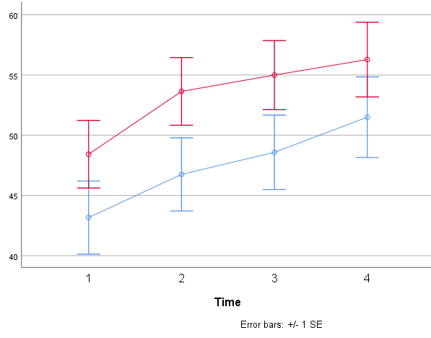
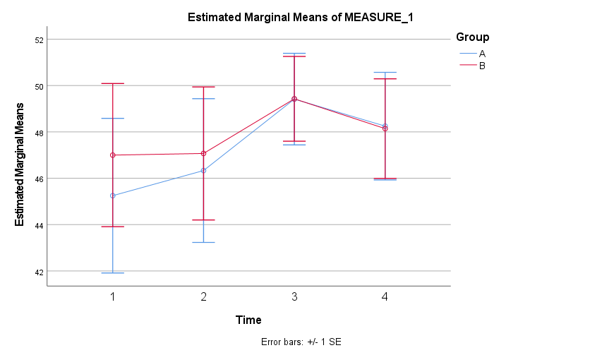
Results- Cognitive performance
No sig effects of stimulation on any measure
Practice effects were observed
Both controlled and automatic attention became faster and, more accurate
Ruff 2 and 7 Automatic Speed T Score
Ruff 2 and 7 Automatic Accuracy T Score
50
50
Stim First
Sham First
Notes:
Other measures no change

Slide 22
Results- Subjective Functioning
Specific improvement was observed with active stimulation for subjective functioning in several domains
Executive Function, Postconcussive symptoms, Sleep, and Depression
15% improvement
About 50% of 4 week inpatient rehab
6% improvement
Notes:
Cross over trial gives smaller effects than RCT because subjects serve as their own control and participant characteristics 100% controlled

Slide 23
Results- Subjective Functioning
16% improvement
9% improvement
Notes:
Scales are all set to 50% total score
All others showed same direction (active benefit): Fatigue, anxiety, cognitive concerns, emotional control, pain, headaches, positivity, self-efficacy
NOTE Blinding was successful…subjects were 50% accurate on condition guesses

Slide 24
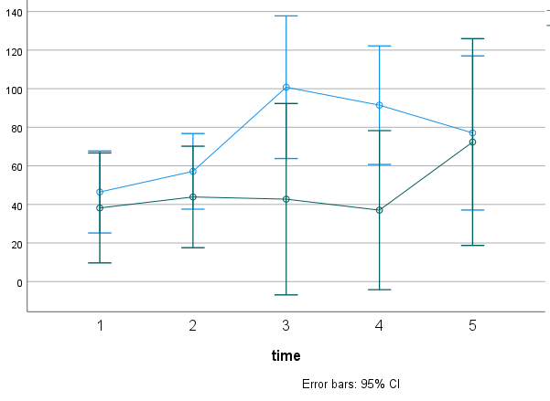
Results: resting EEG
Active TMS did impact slow wave activity
Prefrontal delta elevation – one week after active stimulation
Not same site as stimulation
Delta power FP1
Stim First
Sham First
Notes:
Hypothesis was partially confirmed- delta circuits affected (these are what is primarily altered in resting state in chronic mTBI)
Temporary – you can see it return to baseline in group A
Timing of measurement: captured long term elevation. SHOWS LONG TERM CHANGES FROM TMS
this is a new phenomenon

Slide 25
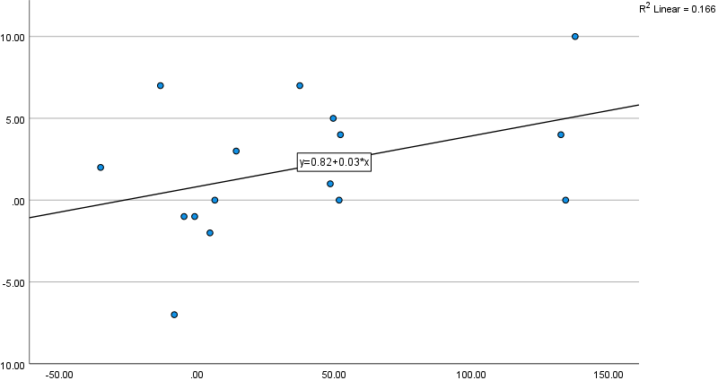
Resting δ elevation vs. symptom gains
Executive Function symptom improvement
Delta Power Elevation 1 week after stimulation (uV^2)
Notes:
P=0.058
Delta power changes were not related to attention performance as we hypothesized. We DID see preliminary evidence the “late elevation” is related to symptom improvement, for depression and subjective executive function.
What is resting delta power about? A mystery, but:
1) Positive mood (Gartner 2014; Wyczesany 2008) and mood changes
2) Concentration, default mode suppression, Suppression of external input: Sternberg and No-Go increase frontal delta
Harmony (2013): “In conclusion, the results suggest that power increases of delta frequencies during mental tasks are associated with functional cortical deafferentation, or inhibition of the sensory afferences that interfere with internal concentration. ”

Slide 26
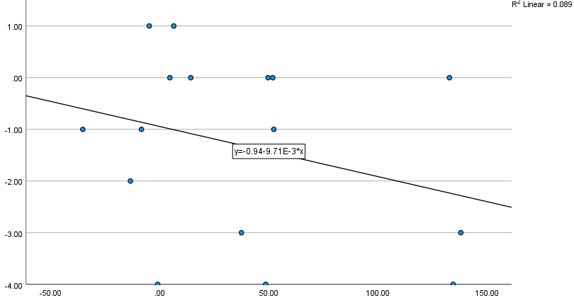
Depression symptom improvement
Delta Power Elevation 1 week after stimulation (uV^2)
Notes:
Trending p=0.2
Only 16 participants had complete EEG data

Slide 27
Remaining analyses: EEG
Have not yet examined:
Alpha, Beta, Gamma frequencies
ERPs – may be some stimulus processing effects
Brain responses to sound targets appear to be enhanced with active rTMS
Resting state measures over task time (vigilance and theta power predicted to sustain longer after TMS)
Notes:
Alpha in particular is associated with alterations in cognitive state
DeBlasio (2013): Delta globally modulated the five ERP components — all amplitudes were more positive with high prestimulus delta, regardless of stimulus condition. (P1, N1, P2, N2, P3)
Hypothesized a reduced amount of low-frequency power over a long vigilance task

Slide 28
Conclusions
rTMS of DLPFC was not effective for improving learning and attention in mTBI
rTMS of DLPFC was effective for depression symptoms, postconcussive symptoms, subjective sleep dysfunction, and subjective executive function in mTBI
Safe and well-tolerated; headaches may be contraindication
Consistent with known efficacy for depression
rTMS to right DLPFC temporarily altered resting delta circuits active over week scale
Longer term elevation of prefrontal delta power predicted symptom improvement, therefore is a clue for the mechanism of rTMS’s efficacy for executive and depression symptoms

Slide 29
Clinical significance
Statistically significant improvements in PCS, sleep, depression, and executive function
While there was no improvement in objective cognition, subjective functioning may be even more important:
Neurobehavioral and psychological symptoms elevated in mTBI but neuropsychological function is typically normal
Midlife signals of poor outcomes in aging
Most prominent physiologic brain signal in chronic mTBI is strongly associated with depression and anxiety symptoms
rTMS may benefit mTBI with subjective cognitive deficits, especially for those with PCS, depression, and/or sleep disorders
rTMS may create a window of plasticity, priming for other rehab programs
Notes:
For instance, in LIMBIC-CENC in inpatient TBI sample 75% report affective symptoms and subjective sleep dysfunction

Slide 30
Discussion: why no improvement in neuropsychological performance?
Not clinically depressed:
Neuropsychological benefits in medically refractory depression¹, and TBI groups selected for depression²
Our results similar to very recent study in severe TBI (no neuropsychological benefit)³
TBI depressive symptoms less severe, less problematic for cognition than refractory clinical depression
Possibility of other neuropsych process impacted, harder to measure –e.g. meta-cognition
RDLPFC associated with accuracy of self-assessment
Notes:
References
Nadeau 2013
Lee 2018
Neville 2019

Slide 31
Discussion: what is the late delta elevation?
Long-term but not permanent changes in large scale cortical communication
Delta modulates local activity over large regions
Long-term but impermanent plasticity of networks:
EEG correlate of long-term network Hebbian learning? Delta power rebound in motor cortex-connected regions after movement activity
Temporary Changes in ‘Internalizing’:
Inward mentation, loss of response to external world
Positive mood and serotonergic manipulations
Notes:
We don’t know of course, these are theories:
What is it biologically?
What is its functional significance? Not attention and learning as we saw

Slide 32
Other approaches to protocol?
How might one affect objective cognitive functioning?
DLPFC for symptoms followed by cognitive training
Outcomes: self-awareness; monitoring

Slide 33
Status and Plans
Manuscript underway
Analyze stimulus processing and vigilance measures

Slide 34
Acknowledgements
Intervention staff
Sheryl Underwood
Padraic Flynn
Advisory Leadership
David Cifu
William Walker
Kathryn Holloway
Ravi Hadimani
Biostatistician
Robert Perera
VA institutional advisor
Tiffany Lewis
Special thank you to George Gitchel
McGuire Research Institute
Notes:
The people who made this possible. Thank you!

